Slide 1
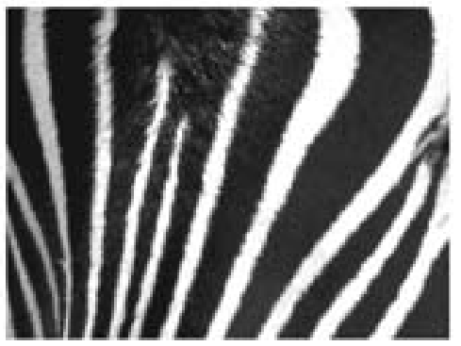
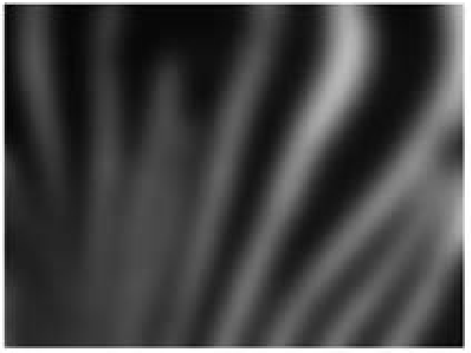
Notices News & Events New article Project Updates LEELAB paper summary
JaeRong Ahn and Inah Lee, Hippocampus 2014
Intact CA3 in the Hippocampus is Only Sufficient for Contextual Behavior Based on Well-Learned and Unaltered Visual Background
Summarized by 재민
Background
Pattern separation and pattern completion
→ Dentate Gyrus(DG)에서 일어날 것이라고 추측됨
(O’Reilly and McClelland, 1994; Treves and Rolls, 1994)
existing memory representation for env1
Common memory representation (env1)
...if it is silghtly modified ver. of env1
vs.
later stimulus for env2
Different memory representation (env2)
... if it is similiar but different from env1

Slide 2
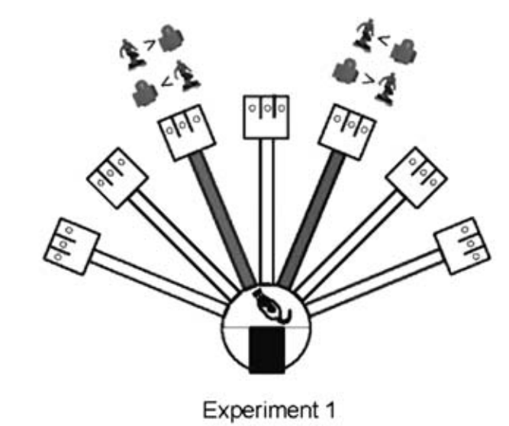
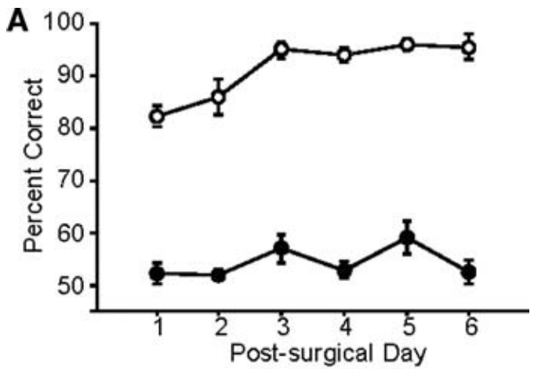
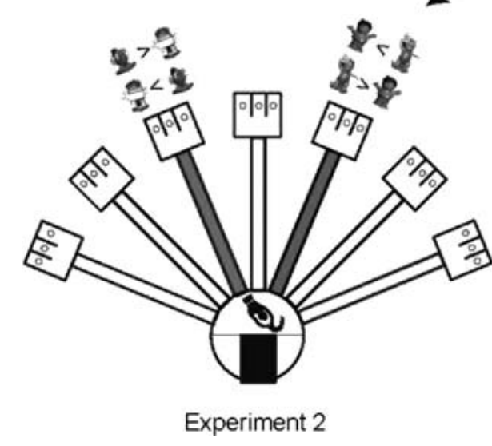
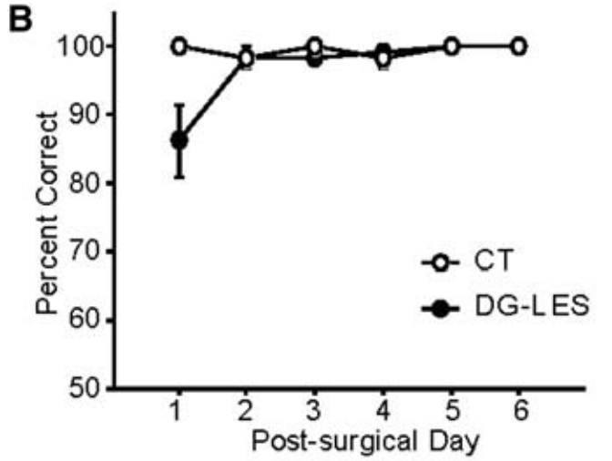
Notices News & Events New article Project Updates LEELAB paper summary
Background → Hypothesis & Expected Outcome → Method → Result → Conclusion, Caveat & Implication
Pattern separation and pattern completion
→ Dentate Gyrus(DG)에서 일어날 것이라고 추측됨
(O’Reilly and McClelland, 1994; Treves and Rolls, 1994)
→ 실제로 DG lesion rat은 비슷한 object-place 연합을 학습할 때, task performance deficit을 보임
(Gilbet et al., 2001; Lee and Solivan, 2010)
두 place에 같은 object pair가 연합되었을 때
Control
두 place에 다른 object pair가 연합되었을 때
Control
No deficit
Deficit
DG lesion
DG lesion
Lee, I., & Solivan F. (2010). Learning and memory.

Slide 3
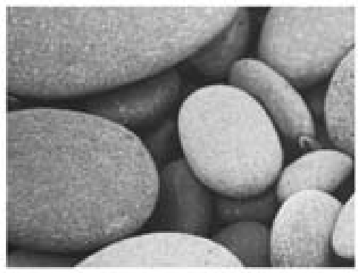
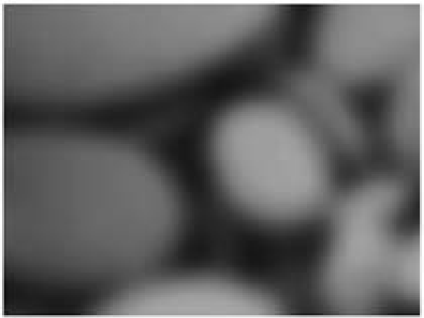
Notices News & Events New article Project Updates LEELAB paper summary
Background → Hypothesis & Expected Outcome → Method → Result → Conclusion, Caveat & Implication
DG가 spatial pattern separation 뿐만 아니라, non-spatial pattern separation에도 중요한 역할을 할 것이다.
Expected Outcome
Training
Test
No deficit in both control and DG lesion rats
Button 1
Button 2
Same scene
association between non-spatial stimuli
Performance deficit only in DG lesion rats
Blurred scene

Slide 4
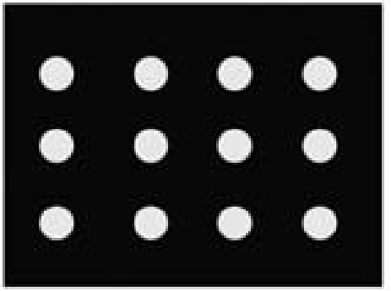

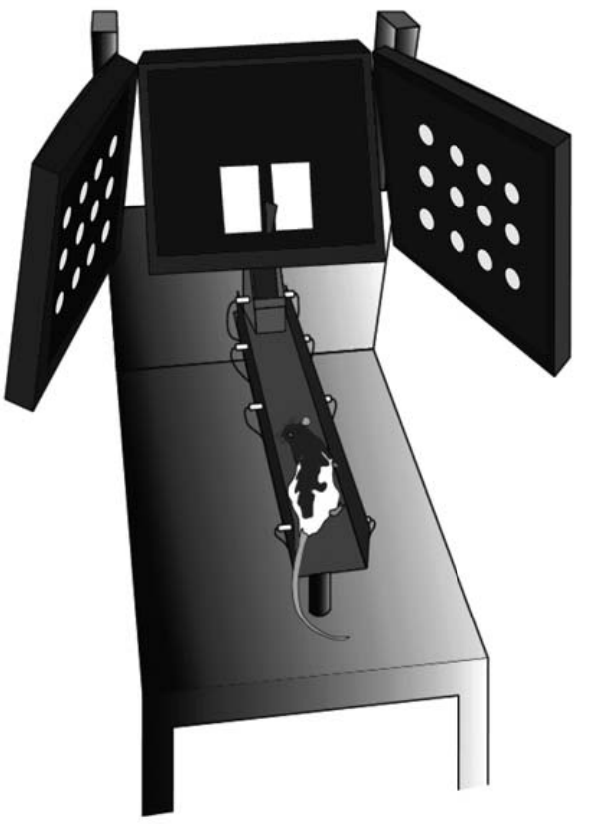
Notices News & Events New article Project Updates LEELAB paper summary
Background → Hypothesis & Expected Outcome → Method → Result → Conclusion, Caveat & Implication
좌우 모니터의 scene을 보고, 중앙 모니터의 2개 터치스크린 중 하나를 선택하는 task
Dot – Square
acquisition
Left
Right
Surgery (DG lesion w/ colchicine)
Dot – Square
retrieval
Left
Right
New scene pair acquisition (Zebra-Pebbles)
Left
Right
Zebra-Pebbles retrieval, intermixed with blurred scene
Left
Right

Slide 5
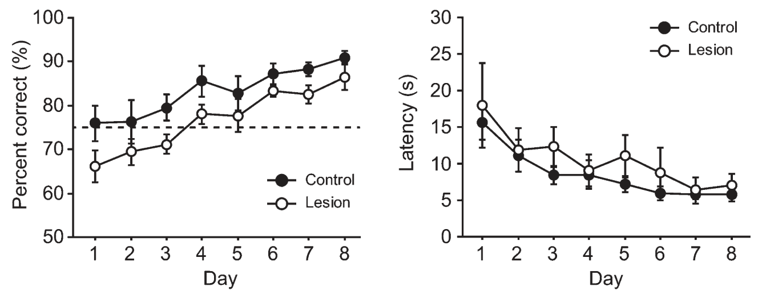
Notices News & Events New article Project Updates LEELAB paper summary
Background → Hypothesis & Expected Outcome → Method → Result → Conclusion, Caveat & Implication
1. DG lesion 전에 학습한 scene pair를 retrieval → deficit 없음
n.s.
n.s.

Slide 6
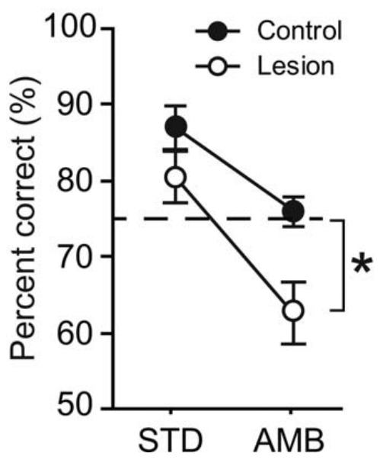
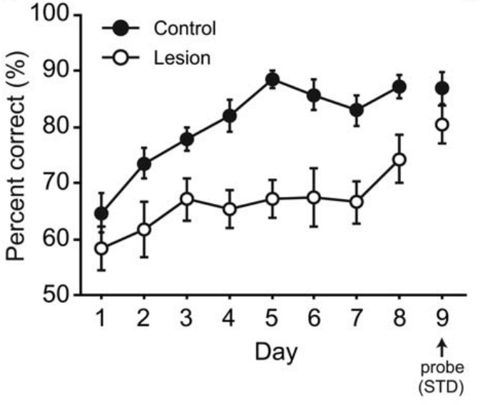
Notices News & Events New article Project Updates LEELAB paper summary
Background → Hypothesis & Expected Outcome → Method → Result → Conclusion, Caveat & Implication
2. New scene pair acquisition→ deficit 없음
3. learned scene으로 task 수행→ deficit 없음 ambiguous scene으로 task 수행→ deficit
n.s.
DG lesion group이 학습에 더 오래 걸렸으나, control group과 같은 accuracy까지 도달 성공

Slide 7
Notices News & Events New article Project Updates LEELAB paper summary
Background → Hypothesis & Expected Outcome → Method → Result → Conclusion, Caveat & Implication
DG가 non-spatial pattern separation에 중요한 역할을 할 것이다.
→ DG lesion rat의 non-spatial association task performance는 stimuli의 작은 변화에도 easily disrupted 됨
실험에서 impair된 pattern completion 은 CA3의 기능이 아닌가? → CA3가 DG를 거치지 않은 EC input을 받아서 pattern completion을 제대로 하지 못했을 것 (Lee C.H. and Lee I., 2020에서 후속 연구가 진행됨)
DG와 CA3가 모두 pattern completion에 중요한지, DG만 필요한지가 연구에서 확실히 밝혀지지 않음 (Lee C.H. and Lee I., 2020에서 후속 연구가 진행됨)
Blur가 너무 심해서 new scene으로 인지한 것? Control group에서도 blurred scene trial에서 accuracy 저하가 나타났기 때문에, 낮은 blur level에서는 DG lesion rat의 performance deficit이 나타나지 않을 수 있음

